Slide 1
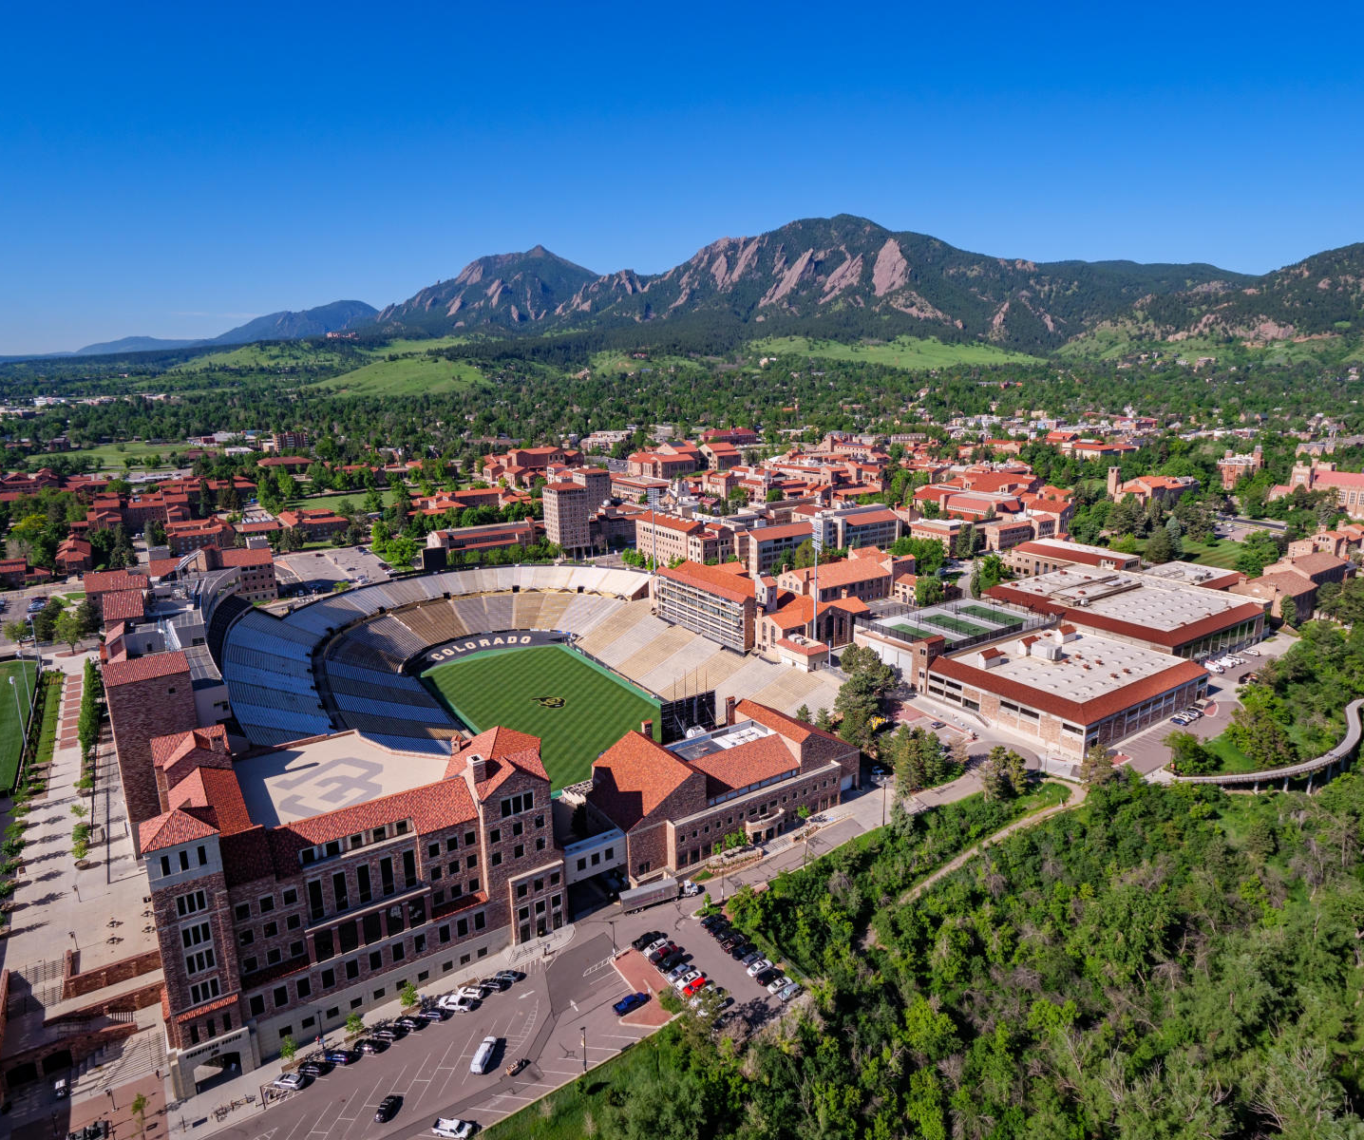
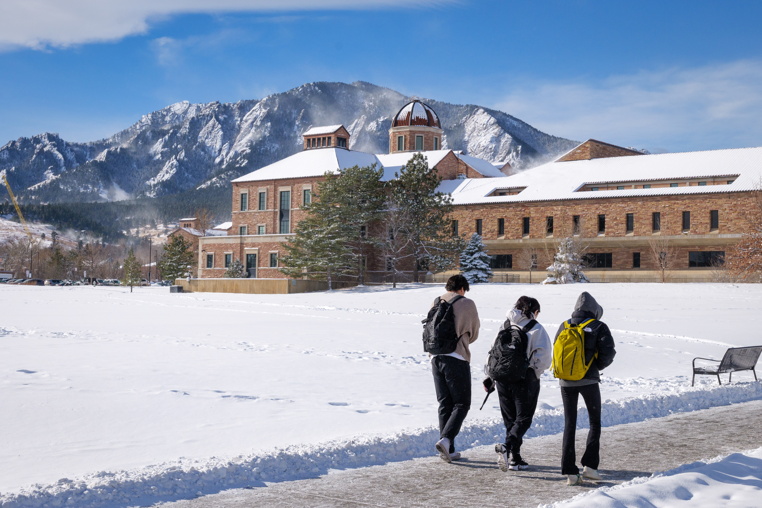
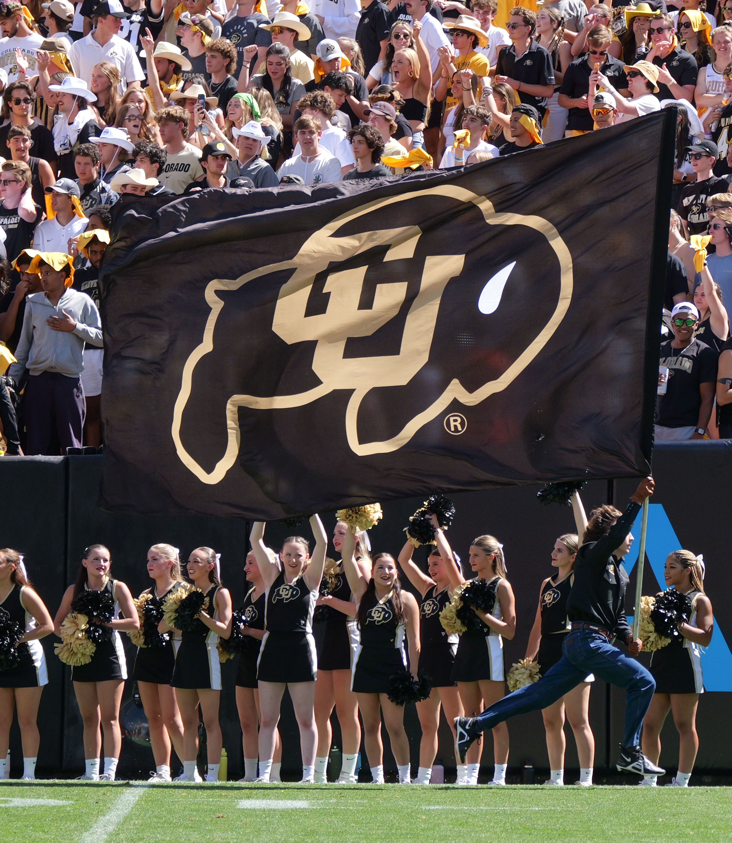
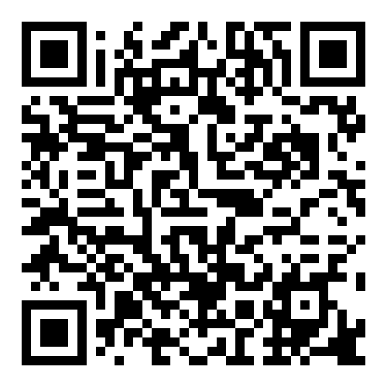
Apply to CU Boulder ECEE
Use the QR code for full details of the application process, including the PhD Information Session recording and slides, and the links to sign-up for a master’s information session.
The deadline for PhD applicants for Fall is December 15; the deadline for MS applicants for Fall is February 15.
Email Lori.Meehan@colorado.edu with any questions.

